Slide 1

Troop Cookie Manager Training
November 16, 2023

Slide 2

Agenda
Who should I know
Commonly used terms
What do the Girl Learn
Meet the Cookies
Where does the money goes
2024 Theme
2024 Updates
Systems
  M2 Media platform
  Ebudde
Ways to Sell
Goals

Slide 3
Who should I know
Service Unit (SU) Cookie Manager
  Nicole McGee
    4 years as SU Cookie Manger
  Melissa Perez
    (Shadowing to take over next year)
    2 Years as Troop Cookie Manager
Service Unit Booth Coordinator- April Mason
  3 years as SU Booth Coordinator Manger
Contact at SU809cookies@gmail.com

Slide 4
Commonly used terms
TCM- Troop Cookie Manger
SU- Service Unit
Cookie Cupboard- Volunteer ran; where troops can pick up additional cookies
Proceeds- The funds going directly to the Troop per package sold
PGA- Per girl Average, average number of packages sold pers selling members in the troop. This number is calculated by taking the total number of packages sold dividing it by the number of members selling
IO- Initial Order
DOC- Digital Order Form
Intertroop transfer- If a troop orders to many they can post what they have a troop ineed can pick them up it’s a win win for both troops
ACH- Automatic bank withdraw

Slide 5

What do the girls learn

Slide 6
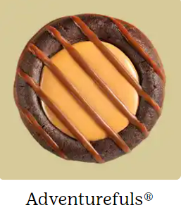
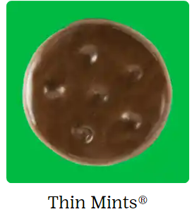
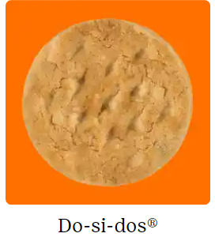

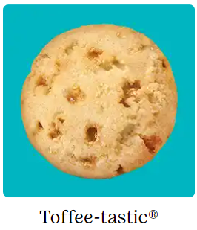
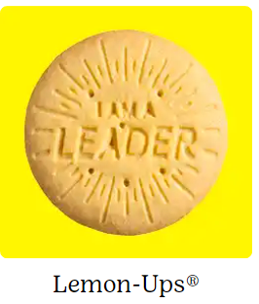
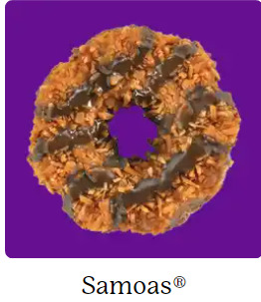
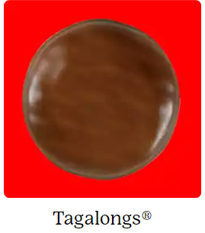
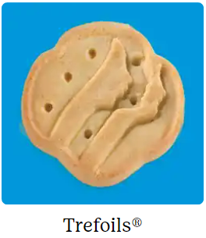
Meet the Cookies
These are the $5.00 Cookies
These are the $6.00

Slide 7
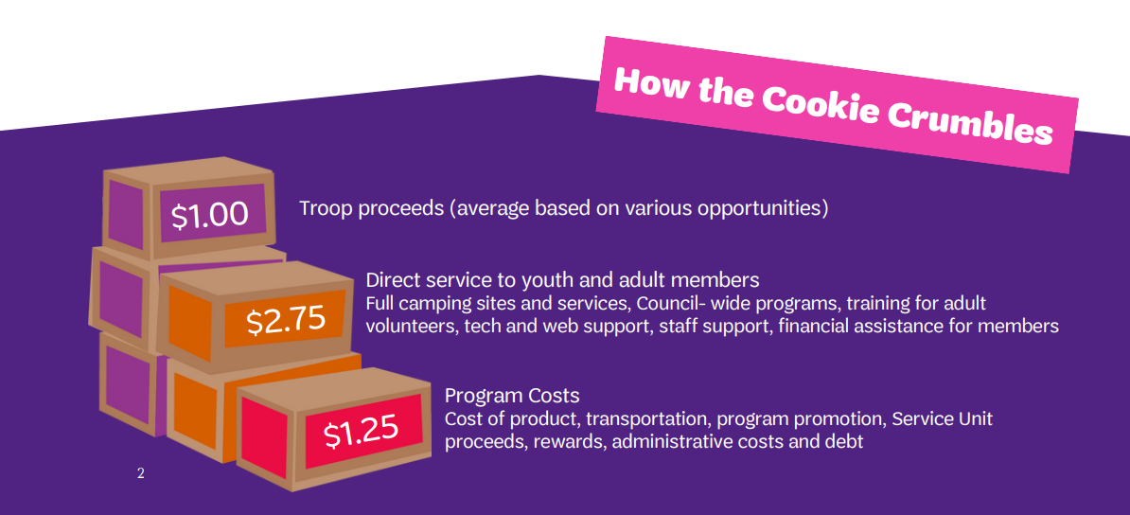
Where does the money go

Slide 8
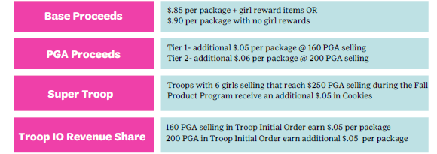
What the troop gets

Slide 9

2024 Theme

Slide 10

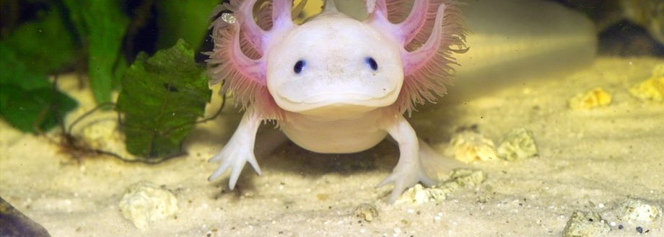

Habitat
Axolotl’s natural habitat is Lake Xochimilco (So-chee-mil-co) in Mexico City, Mexico. Axolotls swim with plants like water lilies and water lettuce, and enjoy companions like crayfish, fish and frogs.
Colorful Camouflage
Axolotls can be found in over
18 colors – including most
Girl Scout Cookie® package colors! They are often pink as pets, but can be grey, green, black and brown in the wild so they blend into their environment.
Gills
A few feathery, external gills on each side of the head provide the axolotl with oxygen and its signature look. Adult axolotls have lungs but rely primarily on these gills to breathe.

Slide 11
2024 Cookie Season- Updates

Slide 12
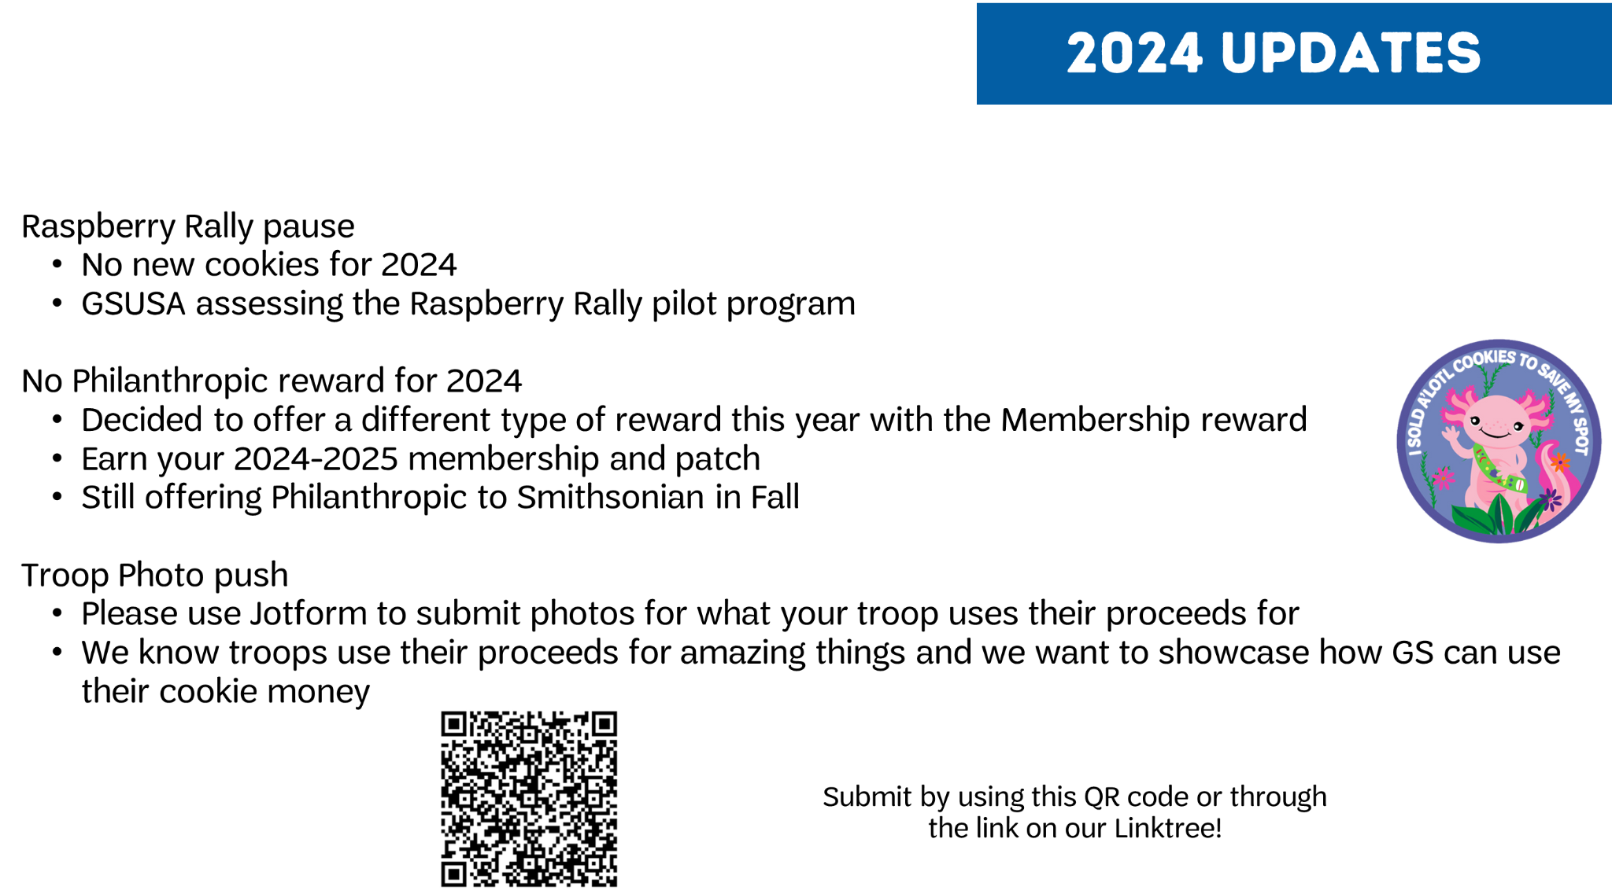
2024 Updates

Slide 13

Important Dates
December 15, 2023- COOKIE SALES BEGIN
January 7, 2024- Online Girl delivery closes
January 9, 2024- Initial Orders due in ebudde
January 6, 2024 at 7:00am- Select 3 Slots- max 1 booth per chain store
January 8, 2024 at 7:00 am- Select 6 Slots- max 2 booths pers chain store
January 10, 2024 at 7:00 am- Wide Open- No restriction
January 15, 2024- Online Girl Delivery Re-Opens
January 16-29, 2024- Cookie Deliveries
January 31, 2024- Test payment ACH $1
February 1-7, 2024- Cookie Cupboards Open
February 2, 2024- Booth Sales Begin
February 27, 2024- ACH #1 $2.50 per package received
March 3, 2024- Girl Delivery Closes
March 10, 2024- Last day of Booth Sales
March 11, 2024- LAST DAY OF COOKIE SALES
March 26, 2024- ACH #2 Remaining Balance
May- Rewards delivered

Slide 14

Service Unit 80-9 Goal
42,356
3% increase from last years total of 41,122

Slide 15
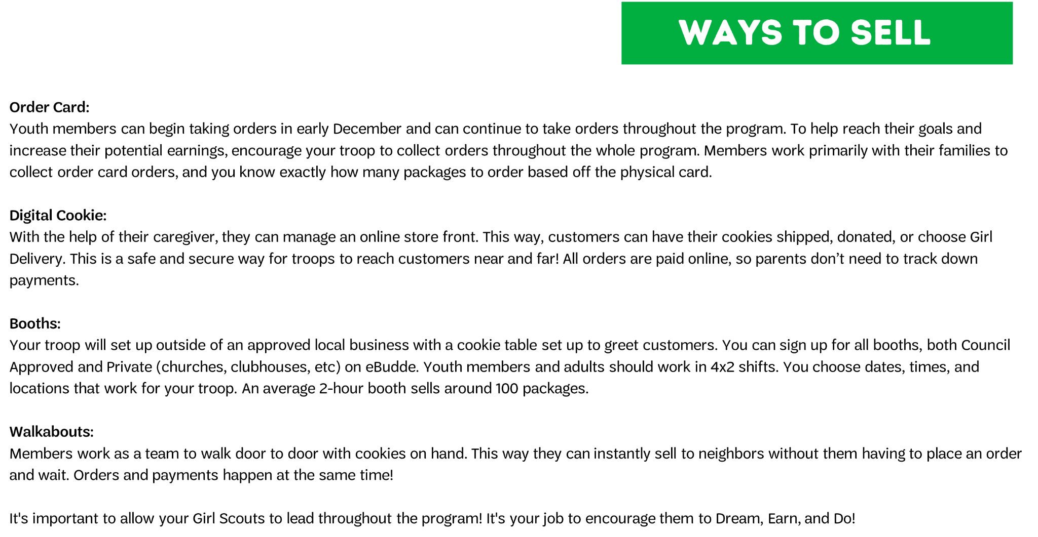
Ways to sell

Slide 16
Systems…Systems…Systems

Slide 17
Tracking Systems
M2 Media Platform
  The TCM uses to send the parents a link to set up their website
  The TCM can view online sales of each girl in troop
  The system girls use to create a website to sell, and track cookies sales
  Access to personalized marketing materials
  UPDATE THIS year girls can take payment online without having to enter billing information
eBudde
  The TCM uses to submit initial order, track cookies, select booths, transfer cookies and rewards
  Parents don't use this

Slide 18
eBudde

Slide 19
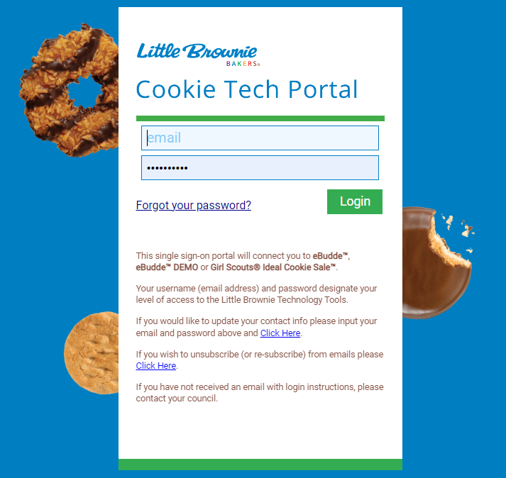
Getting Started with eBudde
All eBudde materials can be accessed using cookieportal.littlebrownie.com
You can also access eBudde from the GSCNC website
You should have received login instructions to your email (check spam!)
*If you haven't received a welcome email, you can click on "Change My Password" to gain access. If you're still having access issues, please contact your SUCM or the Product Program Team

Slide 20
eBudde Tab
Tab | Description
Dashboard | Each troop's default screen. This is where you will see important messages and tools.
Contacts | From here, you can review and edit contact information. Please remove anyone no longer actively associated with the troop. You can add new users here as well.
Settings | You should update this tab every year with correct program level and member goals.
Girls | Here you can add troop member's names, grades, and t-shirt sizes. Click purple ID button to assign them a temporary GSUSA ID.
Initial Order | This is where you enter your troop's Initial Order by member and booth sale cookies. Please note, once this is submitted, it CANNOT be changed.
Delivery | Here you can select your delivery time and view your delivery information.
Girl Orders | Here you can keep track of each member's sales, payments made, and balances due. Girl Delivered cookies get allocated here.
Transaction | Keep track of inter-troop transactions and enter pending Cupboard order requests
Txn Pickups | Please disregard this tab, as our Council does not utilize it.
Cookie Exchange | Have packages of cookies to exchange with other Troops? Use this tab to post what packages you have to the exchange. Please keep this information up-to-date.

Slide 21
eBudde Tabs
Tab | Description
Rewards | Complete, review, and submit reward orders for your troop.
Booth Sites | Sign up for booths and request approval for private booth sales. The Booth Recorder lives here.
Payments | Review ACH withdrawals made by council for accuracy. ONLY council can input/edit deposits.
GOC Org | This is where you list your troop's Hometown Hero.
Sales Report | Keep an eye on this summary tab throughout the program to ensure the information is correct. This report will note the troop's contact information, PGA, selected incentive plan, all packages received, Cupboard visits, inter-troop transactions, ACH withdrawals made by Council, and any amounts still due to Council.
Reports | Run reports from this tab for additional information on delivery and Cupboards.

Slide 22
eBudde- Set Up
Assigning roles in eBudde at the Troop level
    TCMs should only be listed as TCM in eBudde so you don’t lose tabs
    You can make a parent a cookie pickup person to help with cupboard pickups
    Add someone to be a booth recorder only
    Add troop leader in troop leader or troop view only, so they can only view eBudde but not edit
    Girl tab opens Dec. 8: allows you to add any missing youth members to eBudde. Make sure you click on temp ID button
    Insert t-shirt size for all Girl Scouts in troop (regardless of opting out of rewards or NOT). Still eligible for troop rewards when opting out of rewards
    Verify age level and reward decision. You should contact SUCM to have reward decision changed. Daisies and Brownies cannot opt out. Can only opt out until March 6th!
Initial Order
    Ensure troop is ordering by package- NOT case for booth order
    If troop reward is earned, you should remember to add 2 volunteer rewards (lanyard)
    Wait to submit IO until actual day of submission due date to ensure Digital Cookie flows all orders over! January 9th for troops

Slide 23
eBudde
Booth Allocation
  Correct booth allocation = giving youth members credit for cookies sold = correct rewards
  Helps to keep your cookie inventory correct
  See in following seasons the booth locations that were most successful for your troop.
  Stress using the booth recorder for easy allocation
  Add number of packages sold at booth and spread by Girl Scouts that were selling at that booth
Troop to Troop Transfers
  Opportunity to transfer cookies when you have a surplus of a variety or in general too many (for example done selling for the season etc.) and can transfer cookies to another troop
  Troop that is giving away cookies, enters the transaction.
  Enter it under the transaction tab, add a transaction, change from cupboard to troop. Put in troop number going to. Remove product (should default to) add packages, save
Cookie Exchange
  Letting troops in your association know that you have excess cookies available for transfer
  Need to keep this updated. As you transfer the cookies away to other troops, please zero out your posts on the exchange

Slide 24
eBudde
ACH
  Calculating ACH #1: All cookies sold and in troop inventory by 2/22 x $2.50 - All digital sales and test payment ($1) = ACH #1
  Sales Report tab: shows all packages, online payments, and test ACH payment
  ACH Reduction Request: form on the website that troops can fill out if they anticipate being short on the ACH
  Opens on 2/15/24 and closes on 2/22/24
  If a Girl Scout does not have any DOC payments, that means they had large in person orders and they need to collect the money from the customers.
  You should be collecting the money when they deliver the cookies (not before!) and giving the money to the TCM (you!) or TMM to deposit in the troop bank account
Online girl Delivery
  Customers buy directly from youth member’s storefront to have cookies delivered by the Girl Scout
  After IO period, Girl Delivery will reopen, and customers can place orders again
  Caregivers and troop volunteers should work together for this to run smoothly
  Communication is key!
  Cookies from Girl Delivery (after the IO) will need to be allocated in eBudde.

Slide 25
Reports tab
Important for tracking for keeping track of various things throughout the program as well as retaining information from past seasons.
Useful for
  Inventory management
  Ensuring correct rewards
  Correct allocation
  Viewing total sales volume

Slide 26
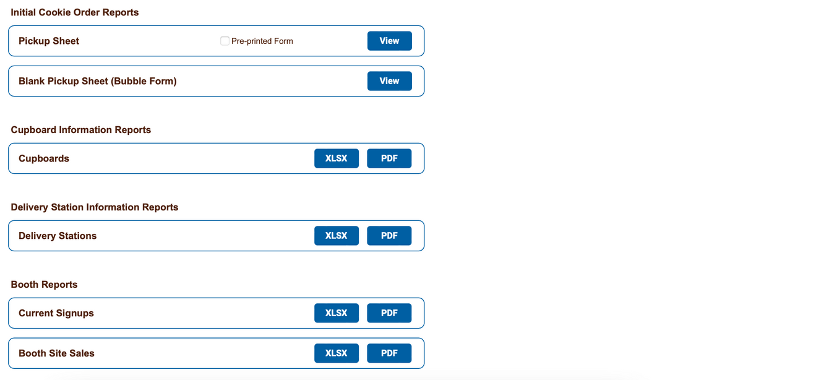
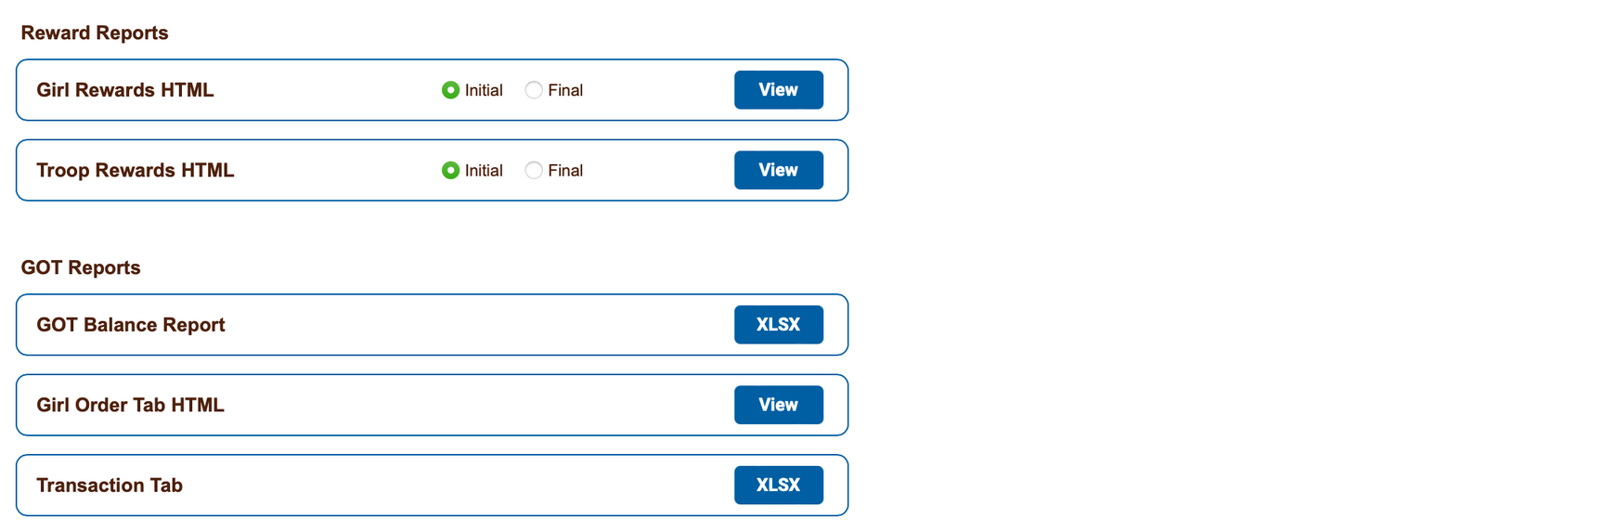
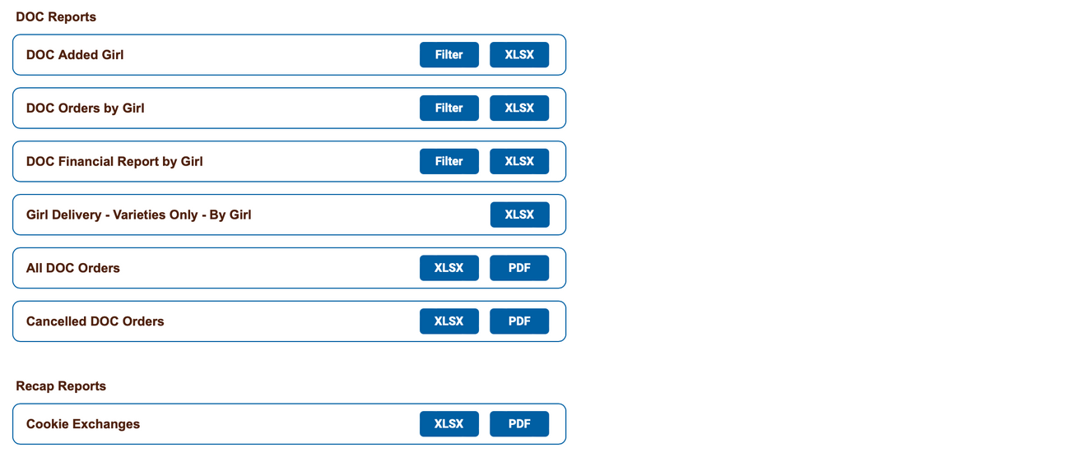
Reports

Slide 27
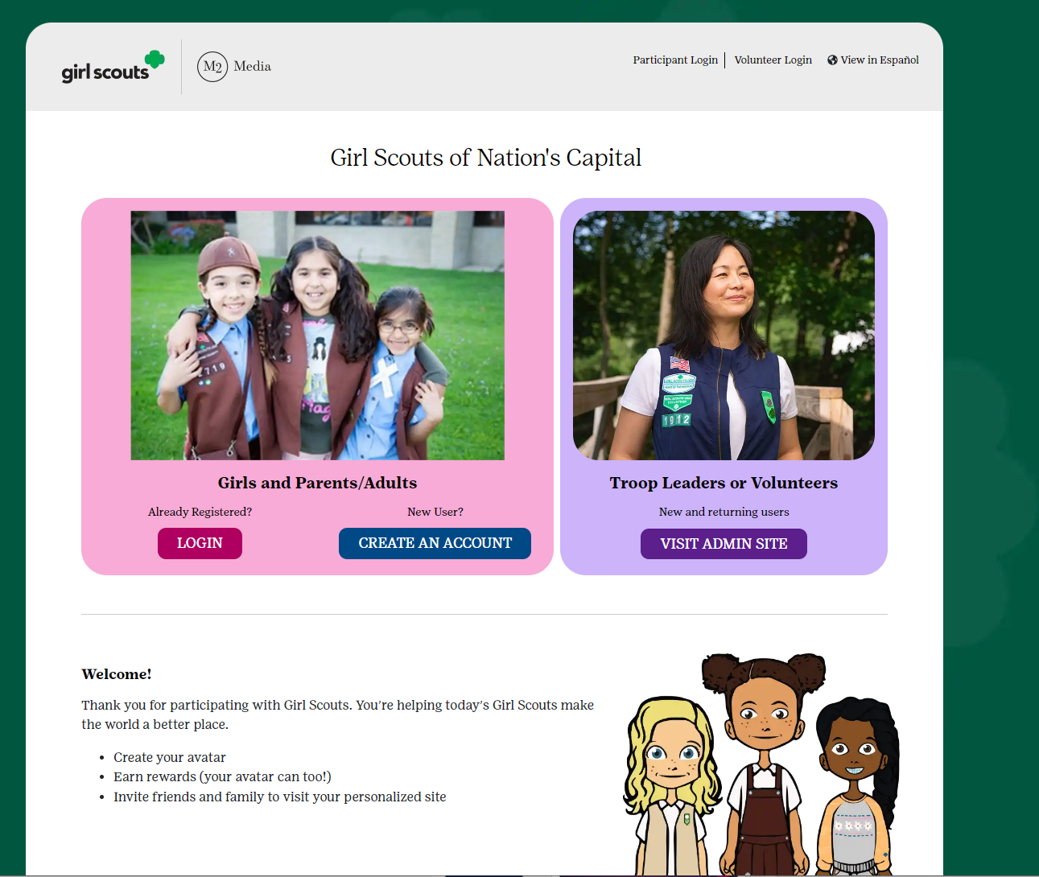
M2 (Digital Cookie)
https://www.gsnutsandmags.com/Campaign/Account/Register/1785

Slide 28
M2 (Digital Cookie)- Getting Started
Prior to the start of the cookie program, Service Unit Managers, Troop Leaders and Troop Cookie Managers will receive an email from the M2 platform inviting them to access the site.
Once received, click on the link that says CLICK HERE to create your password. View training video. After the initial set up, volunteers can return to the admin site via www.gsdigitalcookie.com/gsnationscapital and click on the Administration Site button.
Use your email address and the password you created to login. If you participated in the online Fall Product Program or Digital Cookie Pilot, use the same login. If you don’t remember your password, click on the login button and then click forgot password
Create your Avatar and upload an optional troop video.
If the members in your troop sell a total of $1,000 online, the Troop Cookie Manager will earn their personalized avatar patch. Parent emails will be uploaded into the system. Send them an email using the digital cookie site that will include the link and instructions on how to participate in the program.
You can also communicate reminders and words of encouragement for the Girl Scouts as the season progresses. One parent email per child.
The Troop Dashboard is Campaign Headquarters. This is where you will find the troop's online sales at a glance, send email blasts to parents and view reports. These reports will be helpful for online purchases/girl delivery sales .
You can also pull reports from eBudde. Our council does NOT utilize the Digital Cookie app. This is GSUSA's digital platform, and it will not work for our cookie program.

Slide 29
M2 (Digital Cookie)- Transactions
Donated: In eBudde, you will see this inventory as “VT2T” boxes assigned to the troop member and automatically added to the troop without a variety attached to them. The council handles the donation of these boxes and you do not need to supply any inventory or do any eBudde entries for these boxes.
Direct Shipped: You will see this inventory as boxes assigned to the troop member and packages added to the troop automatically. You do not need to do any eBudde entry to account for those packages.
Girl Delivered: During the Initial Order phase, you will see that there is no inventory as boxes assigned to the troop member, only money. These cookies WILL be INCLUDED in the Initial Order on a dedicated line. This feature reopens on January 15, 2024. After the re-opening, these cookies need to be allocated to troop members in eBudde.
Troop Link: During the program, an email will be sent with a link to the Troop Link where customers can order packages from the troop. Only this link can be shared out with the option for Direct Ship or Donation cookies. Any link with the option for Girl Delivered may not be shared out for safety purposes.

Slide 30
Online girl Delivery Responsibilities
Family | Volunteer (TCM)
The youth member/caretaker should contact the customer via email or phone and thank them for their order. | The TCM needs to tell the troop families that Online Girl Delivery is open once again.
They should communicate to the customer when they think they will acquire the cookies. | The TCM needs to figure out a schedule on when they are going to pull the report, I’m going to tell you about soon, and when they are going to go to the cupboards if they don’t have enough cookies to fulfill the order.
They should work with the customer about when and how to deliver the cookies. | The TCM will need to talk to the troop families about the schedule. That way everyone knows when a cupboard run is happening and when they can get their cookies from you.
The youth member/caretaker should contact their TCM about this new sale. | The TCM will need to keep of record of what cookies the girls are picking up. I suggest the family transaction excel sheet.
Figure out the cupboard run schedule and pick up cookies from TCM to deliver to customer | Run DOC Order by Girl report to check for new orders regularly (on schedule) - caregivers should notify TCM of new orders but they don’t always
Keep record of which orders were delivered and when

Slide 31
Inventory…inventory…inventory

Slide 32
Initial Order
Placing the IO
  All names listed on the Girl Tab will show on the Initial Order tab. Individual level ordering is done in packages, but your troop Initial Order will be rounded up to even cases on the “Cases to Order” line.
  Click on the Initial Order tab.
  Click on a name in the list. The line will highlight. Enter the quantities needed for the troop member in the boxes at the bottom of the page. NOTE: These totals will include the Gift of Caring numbers, but the troop totals at the bottom of the page will not, as the virtual Gift of Caring column is not part of the physical order.
  Verify the individual's total and click “Ok” or press enter.
  Click on the next name to continue entering orders.
IO Submission
  You will need to submit the Initial Cookie Order that you entered and saved previously. Make sure to use the “Submit Order” button when you are confident your order is correct and complete.
  You can only submit your order once, so be sure it is correct before hitting the submit button. If you have changes after submission, contact your Service Unit Cookie Manager immediately.

Slide 33
IO for Cookie Booths

Slide 34
Delivery
Planning your Delivery
  Be aware that troops are responsible for counting and verifying the total number of cases received. When in doubt, recount! The Delivery tab allows you to reserve a time slot and view your delivery information.
  Reserve your preferred pick-up time after submitting the Initial Order and Initial Reward Order. Answer questions regarding delivery. Select your desired time slot by clicking in the box to the right of time.
  Click “Submit My info” They system will confirm your submission
Prepare for delivery
  Choose the right Car based on the cases ordered
  Recruit volunteer to help
  Leave small children at home
  Have a plan and schedule for people to come pick up their cookies
Communicate, Communicate, Communicate

Slide 35
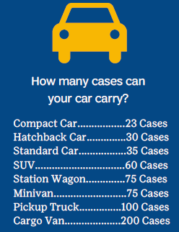
Pick up Cookies- TBD
The Delivery tab allows you to reserve a time slot, and view your delivery information
Reserve your preferred pick up time after submitting the initial order and initial reward order

Slide 36
Allocating Cookies
Throughout the program, as your troop completes booth sales or your troop members get online Girl Delivered orders, you will need to allocate cookies to the troop members, giving them credit for those sales. Proper allocation of cookies ensures your troop members receive the correct rewards they've earned.
Girl Delivered cookies should always be allocated based on the number of actual packages sold per member. This can be done on the Girl Order tab.
Using the booth recorder, you can enter the inventory sold at booths, uncheck any youth member that wasn’t there, click distribute and eBudde will do the work for you and then submit sale. Or you may repeat the first two steps above then manually distribute the cookies (don’t click distribute) to the youth members then submit sale. Using this function saves you time and gives the SU Booth Coordinator data to use to decide if the location is successful.

Slide 37
Booths…Booths…Booths

Slide 38
Booths
Traditional Booths
  Booths set up in front of businesses such as grocery stores, boutiques, and restaurants. These are publicly accessible and open for any troop within the Council to select, regardless of which SU it is in and which Service Unit Cookie Booth Coordinators (SUCBC) solicited the booth location.
  These booths are secured by a SUCBC and submitted to Council staff for approval. They are then uploaded to eBudde for troop selection.
Private Booths
  Booths set up in locations such as a house of worship or fraternal organization. The important distinction is that these booths are not publicly accessible. For example: a parish picnic or a sports banquet at a school.
  These booths are submitted by Troops and approved by a booth coordinator or other appropriate volunteer (usually an ACM). They can also be approved or denied by Council in extenuating circumstances.
  It is up to the SUCBC to ensure that these booths don’t interfere with the business of another approved booth (private or traditional).
Drive-Thru Booths
  These are booths usually held in the parking lot of a school, church, or otherwise publicly accessible business/institution.
  They are submitted in the same manner as a traditional booth but are run slightly differently.

Slide 39
Booths Scheduling
Troops will schedule booth opportunities in eBudde
The only restriction on the number of slots are during the first 3 rounds after that you may choose as many as you want
Booth selection can’t be made on the app until selection is wide open
You can filter available slots by location or by free slots. To search by location, you will click on the plus sign (+) next to the city you are searching. Choose the store and location from the drop-down menu and click the plus sign again to display available dates/times. To search by free slots, click "free slots" at the top center of the page.
Once you've found a location: Choose the date and time range you want by clicking directly on it. This will bring up a small screen on the right that will show available timeframes. Click on the empty cell to the right of the time that you want. Your troop # will appear in the box. Click "submit" to reserve your slot.
You will receive a message that your time is reserved. Click "OK" in the message window to proceed. Should a booth you want be unavailable, you can click on "Notify me if slots open". If it becomes available, you will receive an email to let you know. Keep in mind that this is still a waitlist and reservation is subject to availability.
If you cannot conduct a booth sale during a slot you reserved, please release it as soon as possible. This ensures the booth site does not go unused and all troops get an opportunity to host a sale at that site.

Slide 40
Money… Money…. Money

Slide 41
Money
Signed permission forms and parental consent for financial responsibility of their child's cookies
Using the payment schedule, set deadlines for parents to turn in cookie money. Give yourself plenty of time to organize the payments and deposit them before ACH pulls are done.
Some TCMs find it helpful to collect cookie money from parents weekly or incorporate it into their regular troop meeting schedule.
Make weekly deposits and take bank processing times and holidays into account when planning deposits and deadlines.
The cookie payments will be made in two separate ACH withdrawals. The payment amounts will be posted to eBudde beforehand, but the amount "formula" and payment schedule can also be found in your manual.
There will be one test payment and two real payments, totaling to 3 transactions.
Always note any fees your bank charges, especially if using digital payments at booths. The troop absorbs these fees. They cannot be passed onto customers.

Slide 42
Money
Avoid Financial delinquency
  Document all transactions on the Troop family transactions Record form
  Decline overdraft protection for your bank account
  The troop can decide whether to accept checks or NOT. Recommend npot taking checks
  Do NOT pay in advance for families who have not paid for their cookies
Make sure caregivers understand they are financially responsible for all cookies they pick up
Ensure caregivers signature for all picked up cookies

Slide 43
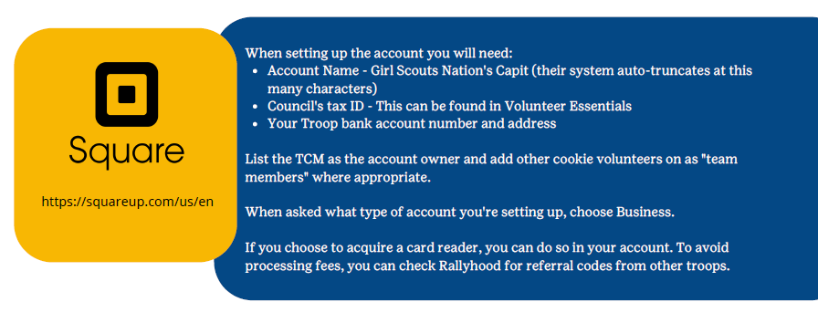
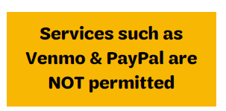
Electronic payment methods
Credit Cards can also be taken via GS Digital Cookie

Slide 44
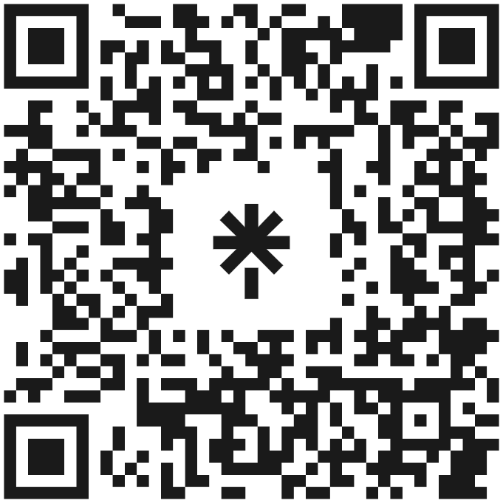
Resources
Little Brownie Bakers Resources
  eBudde Help Center
  LBB Website
  eBudde Microburst Trainings (Youtube)
  eBudde App
Council Resources
  Linktree
  gsLearn
  GSCNC Website
Send an email to su809cookies@gmail.com
QR CODE to Linktree and the TCM Manual

Slide 45

Cheers to a great Cookie Season

